Slide 1
Google Classroom
Study Group
Diana Simpson, Maureen Schmidt, Patrick Monachino, Kathryn Frech

Slide 2
Why Google Classroom
We are already a Google School, so we decided on this project in order to improve our knowledge and mastery of the various ways in which Google Classroom can be used.
Google Classroom lets us communicate with our students, assign homework and projects, flip lessons, post links and documents, and save time and paper.

Slide 3
As a Classroom Teaching & Communication Resource
Easily post notes, videos to watch, and homework for all students before, during, and after the lesson, esp. for those who are absent
Decreases the amount of printed resources and doesn’t get lost
Can post ‘week’ at a glance so all know what is coming
Each time there is a new post or assignment, all students get an email
Accessible anywhere, anytime, from any device
Easily shared with students, co-teachers, and parents

Slide 4
Assessment and Grading
Assignments can be submitted online, graded and returned from anywhere, anytime, any device.
Students no longer have excuses about not knowing or not being in school or ‘forgetting’
You can return papers and still have a copy for your records or for student portfolios
Students can fix their mistakes and you can see what they did before and after
Dates and times are recorded as to what was done when and when submitted for deadlines.

Slide 5
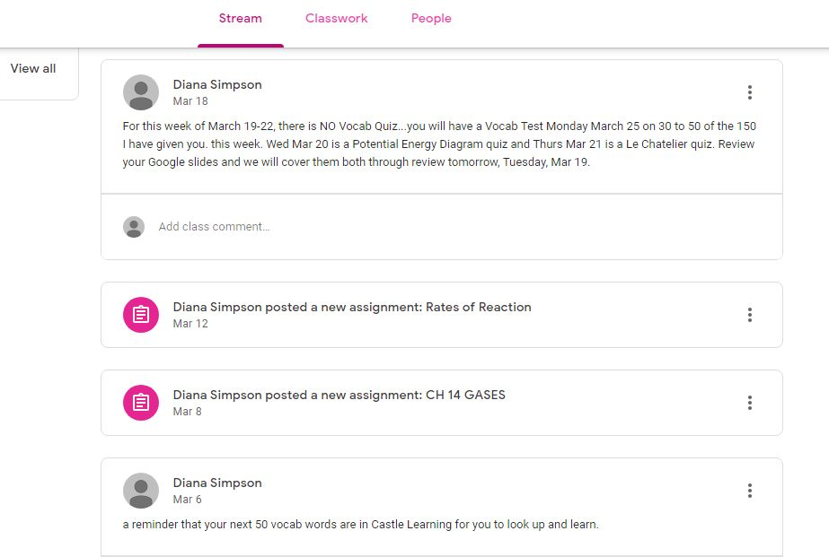
Google Classroom in Use

Slide 6
Swivl
A hands-free recording device that easily records video and audio while you teach
Can be posted to Google Classroom for playback by students and first-time viewing of those who missed class
Can be interactive with students answering questions or commenting via Swivl microphone ‘marker’ accessories
Can be used by shy students to make presentations without an audience present
Can help teachers to ‘see’ what they are doing and improve their teaching

Slide 7
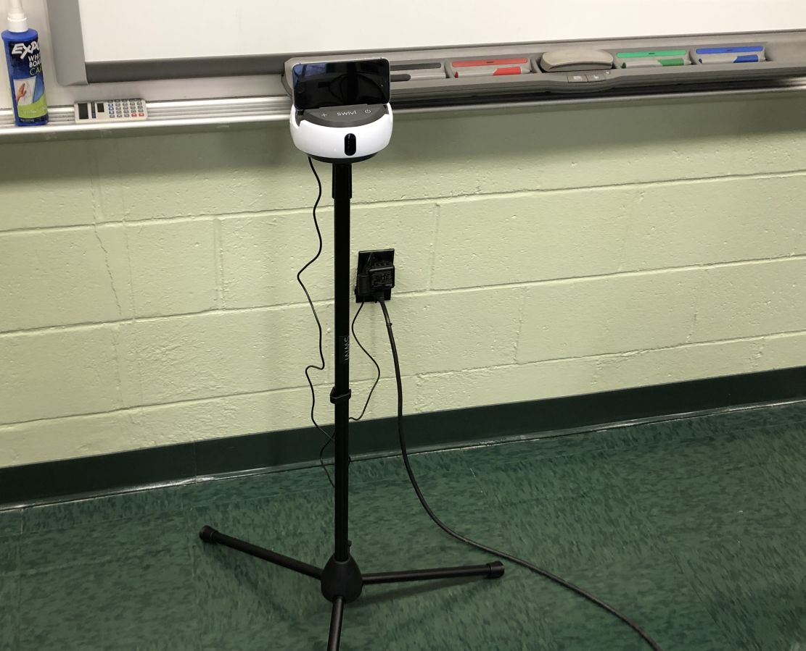
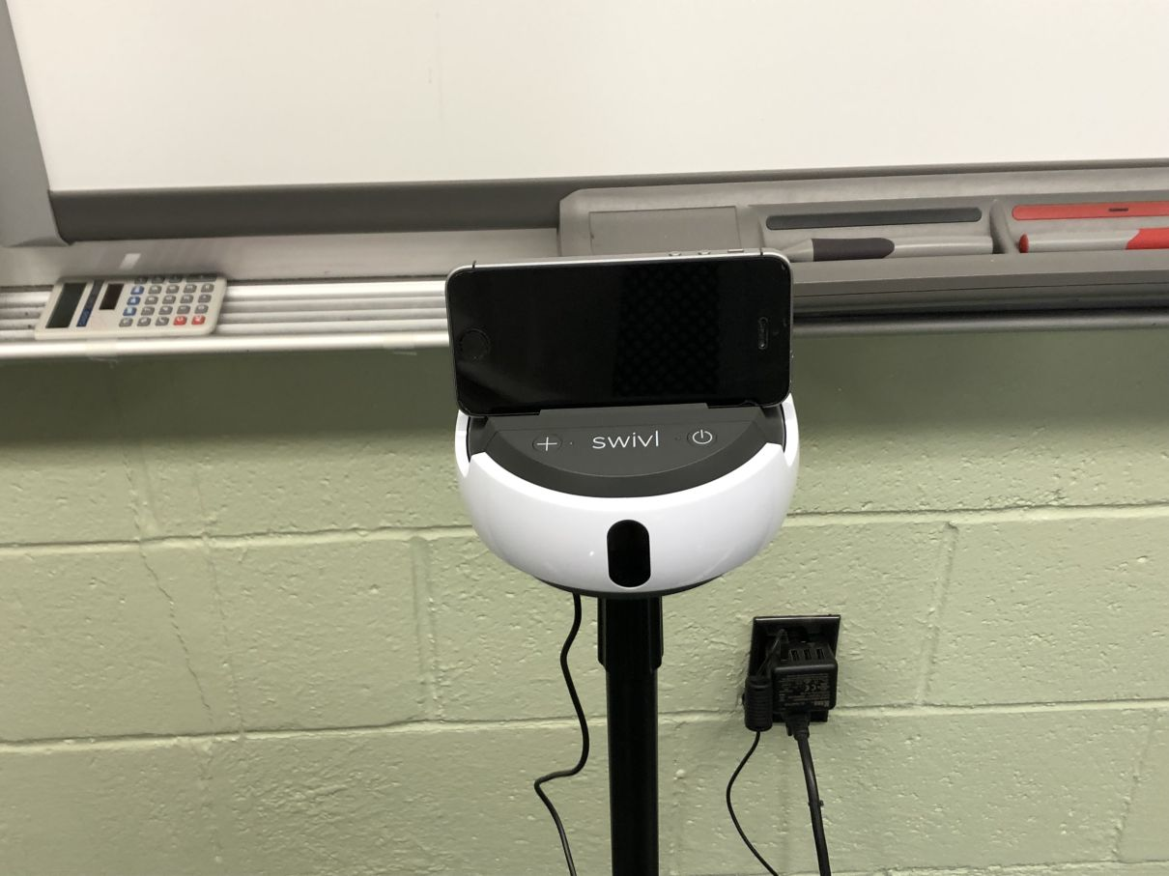
Swivl With iPhone - Ready to Go!

Slide 8
Presentations
When teaching art history, a great way to use Google Slides is to break students into small groups and assign paintings for annotation
Use with the introduction of each new art movement
Each group can then present their slide(s) to the rest of the class through Google Classroom
Slides can be shared between students for studying purposes as well as preparing the presentation without physically meeting
Helps students to be more engaged with what they are studying

Slide 9
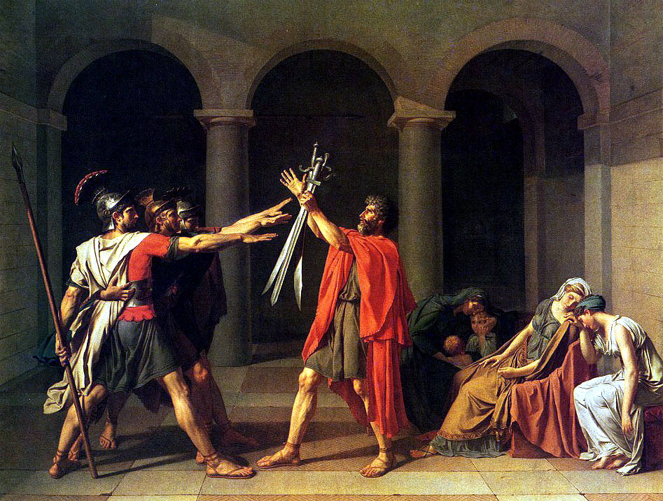
Neoclassicism Art by Jacques Louis David
1
Three arches
Three brothers
Three swords
Three sisters
/wives
2
4
3
"Oath of the Horatii"

Slide 10
Advantages of Importing Videos of Class into Google Classroom
Great resource for absent students
Great resource for students with special needs who benefit from hearing instruction multiple times
Great resource for improving your teaching pedagogy
Can serve as emergency lesson plans
Comment feature in Google Classroom allows for online discussions on videos

Slide 11
Helpful Hints in Making Videos
Make an outline/script
Very easy to ramble
Show your personality
This makes videos much more enjoyable to watch
Search for best programs available
Many free options
To record whole class we recommend Swivl
Experiment
First take may not be the best
Have fun!

Slide 12
Resources, books
Class, Alexa. Google Classroom: 2018 User Manual to Learn Everything You Need to Know About Google Classroom, v. 1. CreateSpace, 2018.
Google Classroom: 202 Survival Guide for Teachers. Modern Educator. CreateSpace, 2017.
Keeler, Alice and Libbi Miller, 50 Things You Can do with Google Classroom. Dave Burgess, 2016.

Slide 13
Resources, online
5 Things to Know About the New Google Classroom
https://shakeuplearning.com/blog/5-things-to-know-about-the-new-google-classroom/
5 Ways to Organize Assignments in Google Classroom https://shakeuplearning.com/blog/how-to-organize-assignments-in-google-classroom/
10 things you might not know about Google Classroom
http://ditchthattextbook.com/2015/12/17/10-things-you-might-not-know-about-google-classroom/
10 tips to use Google Classroom effectively and efficiently
http://ditchthattextbook.com/2016/03/03/10-tips-to-use-google-classroom-effectively-and-efficiently/

Slide 14
Resources, online, pt 2
60 Smarter Ways To Use Google Classroom
https://www.teachthought.com/technology/60-smarter-ways-to-use-google-classroom/
Google Classroom: Email Selected Students
https://alicekeeler.com/2018/09/23/google-classroom-email-selected-students/
Google Classroom: Schedule Assignments
https://alicekeeler.com/2018/09/28/google-classroom-schedule-assignments/
Google: Classroom Support
https://support.google.com/edu/classroom/?hl=en#topic=6020277

Slide 15
Resources, online, pt 3
How to Change Google Classroom Notification Settings
https://www.freetech4teachers.com/2019/01/how-to-change-google-classroom.html
How to Create a Class Template in Google Classroom https://shakeuplearning.com/blog/how-to-create-a-class-template-in-google-classroom/
Three Important Tips on How to Use Google Classroom with Students with Visual Impairment https://www.educatorstechnology.com/2018/11/three-important-tips-on-how-to-use.html

Slide 16
Resources, videos
4 Hidden Features of Google Classroom
https://www.youtube.com/watch?v=bu6IDEBxbFY
Everything You Can Do on Edpuzzle with Google Classroom Integration
https://www.youtube.com/watch?v=JkEb-_snbys
Google Forms 2018-- The Best Free Forms Software?
https://www.youtube.com/watch?v=sJ-uuMBfrcw
NEW 2018 Google Classroom Updates (detailed overview)
https://www.youtube.com/watch?v=S4LXMdIdLFk
Student View Google Classroom - Basic Intro
https://www.youtube.com/watch?v=uVJHM5V7l2M

Slide 17
Swivl Resources
Swivl Starter Guide
https://www.swivl.com/wp-content/uploads/2018/11/Starter-Guide_NOV-2018.pdf
Swivl FAQ
https://swivl.zendesk.com/hc/en-us/categories/115000841607-FAQ
My Top Swivl Tips and Tricks
https://donovanscience.com/2017/09/13/my-top-swivl-tips-and-tricks/
How to use Swivl to record yourself teaching
https://www.goshenlocalschools.org/apps/video/watch.jsp?v=102280
The 7 Deadly Sins of Podcasting | How To Avoid Creating Bad Podcasts Today!
https://www.youtube.com/watch?v=HvNlOTqluHE

